Slide 1
探討學校領導者的健康素養對於實施健康促進學校之作用The Role of School Leaders’ Health Literacy for the Implementation of Health Promoting Schools
健康促進學校國際網絡計畫（109-110年）109年5月份導讀文章
Kevin Dadaczynski , Katharina Rathmann , Thomas Hering and Orkan Okan
Dadaczynski, K., Rathmann, K., Hering, T., & Okan, O. (2020). The Role of School Leaders’ Health Literacy for the Implementation of Health Promoting Schools. International Journal of Environmental Research and Public Health, 17(6), 1855.

Slide 2
01.
Introduction 前言
02.
Materials and Methods 材料與方法
03.
Results 結果
04.
Discussion 討論
05.
Conclusions 結論

Slide 3

01
前言
Introduction

Slide 4
前言－學校領導者
研究指出，學校校長支持度越高，與提高學生行為有顯著相關。(Kam et al., 2003)
而事實證明，學校校長的支持是實施學校綜合體育活動(CSPAP)計畫的重要預測指標，表示校長的支持程度越高，實施CSPAP計畫所組成的部分就越多。(Lee & Welk, 2019)
然而，德國對於實施健康促進學校領導者具體需具備的能力，既無標準的訓練，也無明確的規範。
Notes:
校長的大力支持與學生行為的顯著提高有關（Kam等，2003）。 事實證明，學校校長的支持是實施學校綜合體育活動計劃（CSPAP）的重要預測指標，即校長的支持程度越高，實施CSPAP的組件就越多。（Lee＆Welk，2019 ）
在德國，對於HPS實施學校領導者的具體能力，既沒有標準化的培訓，也沒有明確的規定。
high support from school principals was associated with significant higher improvements in pupil behaviors.(Kam et al., 2003)
the support of the school principal proved to be a significant predictor for the implementation of the Comprehensive School Physical Activity Program (CSPAP), i.e., the higher the principals’ support, the more components of the CSPAP were implemented.(Lee & Welk, 2019)
there is neither standardized training nor any defined regulations for specific competencies on HPS implementation of school leaders in Germany.

Slide 5
前言－健康識能 (1)
一般性的健康識能定義為
“使個人擁有知識、動機及能力，用以獲得、了解、評估及應用健康相關的資訊，使自身在生命歷程與健康照護、疾病預防與健康促進有關的日常生活中，維持或改善生活品質。” (Sorensen, 2012)
Notes:
generic health literacy can be defined as
“people’s knowledge, motivation, and competences to access, understand, appraise, and apply health information in order to make judgments and take decisions in everyday life concerning healthcare, disease prevention, and health promotion.” (Sorensen, 2012)

Slide 6
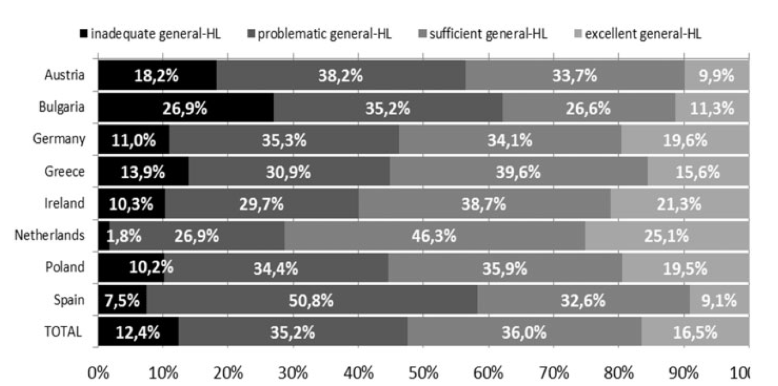
前言－健康識能 (2)
有一項流行病學調查結果顯示，在歐盟8個國家中，年齡15歲以上的人口族群中，47%的人健康素養有限(包含不足及有問題的)。(如左下圖所示)
進一步發現，保加利亞(Bulgaria) 有高達62.1%健康識能有限；而荷蘭(Netherlands)則是健康素養有限的比例最少的國家(28.7%)。
表示社會經濟地位較低健康素養較低。
→62.1%
→28.7%
→47%
Resource: Sørensen, K et al. Health literacy in Europe: Comparative results of the European health literacy survey(HLS-EU). Eur. J. Public Health 2015, 25, 1053–1058.
Notes:
Epidemiological findings from eight EU countries suggest that almost 47% of the population aged 15 years and older had a limited (inadequate or problematic)
health literacy with highest prevalence rates found for Bulgaria (62.1%) and lowest rates for the Netherlands (28.7%)
社會經濟地位較低健康素養較低

Slide 7
前言－健康識能與性別
關於性別的健康素養文獻有著不同的結果。
德國調查健康素養與性別無差異。 (Schae & Berens, 2017 ; Jordan & Hoebel, 2015)
英國一項研究結果顯示，針對成人719位進行調查，男性更有可能表現出有限的健康識能 (OR: 2.04; 95% CI: 1.16–3.5) (VonWagner et al., 2007).
另一項研究指出，男性在理解醫療的形式、藥物使用說明以及醫療人員所提供的訊息方面存在更多的問題。.(Lee & Kim, 2015)
Notes:
關於性別的健康素養文獻有著不同的結果。
While representative German surveys did not report any gender differences (Schae & Berens, 2017 ; Jordan & Hoebel, 2015)德國調查健康素養與性別無差異。
Results from a national sample of British adults (n = 719) revealed that men were more likely to show a limited functional health literacy (OR: 2.04; 95% CI: 1.16–3.5) (VonWagner et al., 2007).
Lee et al. reported that males had more problems in understanding medical forms, directions on medication bottles, and written information oared by health care providers.(Lee & Kim, 2015)

Slide 8
前言－健康促進學校領導者
目前為止，少數關於老師群體相關的研究中，沒有資料顯示領導者的健康識能資料。
學校校長和管理人員是啟動和支撐推動健康促進學校的把關者(gatekeepers) (Dadaczynski & Paulus, 2015)
德國的研究表明，在健康促進學校方面，學校領導者支持最高是小學 ，最低則是中學(Dadaczynski & Paulus, 2011)
然而目前健康識能實證研究沒有區分領導者的職務，也未考量學校類型的差別。
Notes:
the few studies available so far relate to the professional group of teachers while no findings are available on the health literacy of school leaders
school principals and managers are gatekeepers for the initiation and sustainable anchoring of activities on school health promotion
German study showed that primary school leaders indicated the highest and that secondary school leaders indicated the lowest need for support in the area of school health promotion德國健康促進領域支持最高是小學 ，最低是中學
然而目前健康識能實證研究沒有區分領導的職務，也未考量學校類型的差別

Slide 9
前言－研究目的
1.探討學校領導者之健康素養程度
2.探討學校領導者之健康素養與人口學及工作相關特徵之相關
3.將人口學變項、其他學校領導者導向之因素校正後，學校領導者之健康識能與健康促進學校實施之等級之相關。
Notes:
1. What is the level of health literacy among school leaders?
2. What sociodemographic and work-related characteristics are associated with health literacy of school leaders?
3. What is the relationship between health literacy of school leaders and the level of HPS implementation taking into account sociodemographic characteristics and other school leader-oriented factors (HPS related attitudes, competencies, and self-efficacy)?

Slide 10
02
材料與方法
Materials and Methods

Slide 11

2.1. 研究設計
這樣研究屬於另一項大規模調查的一部份(下圖為該研究地區的時間序列)，該調查主要是研究學校領導者的工作和健康狀況，並探討他們在實施健康促進學校中的作用。
為了確保研究的可比較性，每項研究均使用了核心問卷，並有其他量表作為補充。
2012-2013
2014-2016
北萊茵-威斯伐倫州(n = 2.039)
柏林 (n = 237)
下薩克森州 (n = 1.336)
石勒蘇益格-荷爾斯泰因(n = 714)
Notes:
Berlin (n = 237)
Lower Saxony(n = 1.336)
Schleswig-Holstein (n = 714)
This cross-sectional study was part of a larger survey which aimed to investigate the work and health situation of German school leaders and to examine their role in the implementation of school health promotion.
To ensure comparability, a core questionnaire was used in each study, which was supplemented by additional scales and items

Slide 12
2.1.研究對象
研究對象包含一般及職業學校中，學校校長及學校管理委員會成員。
所有參與者皆透過電子郵件及電子報邀請，其中包含兩次來自德國黑森州學校校長的提醒。
參與者皆為自願，並確保受訪者皆為匿名填答。
Notes:
目標人群是普通學校和職業學校的校長和學校管理委員會成員（例如副校長）。 所有合格的參與者均通過電子郵件和新聞通訊的邀請，其中包括黑森州校長協會的兩次提醒。 參與是自願的，並確保了匿名。
The target group was school principals and members of the school management boards (e.g., vice-principals) in general and vocational schools.
All eligible participants were invited by email and newsletter, including two reminders by the Hesse association of school principals.
Participation was voluntary, and anonymity was assured

Slide 13
2.2. Measures 研究工具
人口學及工作特性
性別(Gender)(男、女)
年齡(Age)(小於等於45歲、46至60歲、超過60歲)
學校類型(Type of school )(小學、文法學校、高級文理中學gymnasium、有特殊需求的兒童學校(如：殘障人士)、職業學校(例如：綜合學校)
專業角色(Professional role)(學校校長、學校管理委員會成員)
Notes:
Gender (male, female)
Age (45 years,46 to 60 years, and >60 years)
Type of school (primary school, grammar/high school (gymnasium)
Schools for children with special educational needs (e.g., disabilities)
Vocational school, others (e.g., comprehensive and mixed schools)
Professional role (school principal and member of the school management board)

Slide 14
Health literacy健康識能
採用歐洲健康識能量表(HLS-EU-16)，共16 題。
評量尺度為受訪者認為題目的容易程度(1=非常容易；4=非常困難)
例如：您能找到處理心理健康方面問題的資訊嗎？（如：壓力或憂鬱症狀）
r = 0.82 ; Cronbach’s 0.90
然而後續資料分析進一步將非常容易及容易轉變為1，非常困難及困難轉變為0，而將所有題項分數加總後，最少0分最多16分，轉變為以下分類方式：
健康識能不足(0-8分)
有問題的健康識能(9-12分)
健康識能充足sufficient health literacy (13-16分)
→健康識能不足limited health literacy
Notes:
歐洲健康素養調查問卷（HLS-EU-16），16個 受訪者評估了他們認為任務或活動的簡單程度（1 =非常簡單，4 =非常困難）。 例如，“從非常容易到非常困難的程度，您會說找到有關如何處理壓力或抑鬱等心理健康問題的信息有多容易？” r = 0.82;克朗巴赫的0.90
健康素養不足
有問題的健康素養（9至12分
European Health Literacy Survey Questionnaire (HLS-EU-16),16 items
respondents assessing how simple they think the task or activity is (1 = very simple and 4 = very difficult).
e.g., “ On a scale from very easy to very difficult, how easy would you say it is to find information on how to manage mental health problems like stress or depression?”
r = 0.82 ; Cronbach’s 0.90
1 = very simple/ fairly simple and 0 = fairly difficult/ difficult

Slide 15
HPS related competencies HPS相關能力
獲取促進學生和教職員工的感知能力。共3題。(Wilde et al., )
Personal attitudes towards HPS 個人對於HPS的態度
主要針對受訪者對促進學生健康的重要性的認識、教師或健康對於工作和學習能力的重要性 。
例如：我認為以健康的方式為學校工作人員和學生創造我學校的工作和學習條件很重要
Cronbach’s 0.76
包含態度、能力及自我效能，共6題。
例如：我不確定如何在學校中支持有關學校健康促進和預防的活動\
Cronbach’s 0.82.
Notes:
包括態度，能力和自我效能感，六個項目 受訪者對促進學生健康的重要性的認識 教師或健康對於工作和學習能力的重要性 例如，“我認為以健康的方式為學校工作人員和學生創造我學校的工作和學習條件很重要。” 克倫巴赫的0.76
捕獲了促進學生和教職員工健康的感知能力，這三個項目（Wilde等，） 例如，“我不確定如何在學校中支持有關學校健康促進和預防的活動。” 克朗巴赫的0.82。
included attitudes, competencies, and self-efficacy, six items
the perceived importance of the respondents to promote the health of pupils
teachers or the perceived importance of health for the work and learning ability
e.g., “I think it is important that the working and learning conditions at my school are created in a health promoting way for the school sta and the pupils.”
Cronbach’s 0.76
captured the perceived ability to promote the health of pupils and the school staff, three items(Wilde et al., )
e.g., “I am not sure how I can support activities on school health promotion and prevention at my school.”
Cronbach’s 0.82.

Slide 16
Occupational self-efficacy 職業的自我效能
Level of HPS implementation HPS實施等級
此量表指的是完成工作相關任務的主觀能力，共6題，(Abele et al, 2000)。
例如：健康促進及健康目標已納入我們學校的計畫中。
例如：我知道只要我願意我就能滿足工作上所提出的需求。
Cronbach’s 0.90.
Cronbach’s 0.73
此變項為依變項
例如：在我們學校，學生支持健康促進行為的發展
共8題 (Harazd et al, 2009)。
Notes:
Occupational self-efficacy 職業的自我效能
Abele et al six items
the scale is domain specific and refers to the
subjective abilities to successfully fulfil job-related tasks.
e.g., “I know exactly that I can meet the demands placed on my profession if I only want to.”
Cronbach’s 0.73
Level of HPS implementation HPS實施等級
Harazd et al
Health promotion and health goals are integrated in the mission statement and program of our school
At our school, pupils are supported in the development of health-promoting behavior
Cronbach’s 0.90.

Slide 17
2.3. 資料分析
區集 1
區集 2
區集 3
包含人口學統計sociodemographic及工作特性 work characteristics
(除了區集1的變項之外) 包含健康促進學校的態度HPS attitudes、能力competencies以及自我效能self-efficacy。
除了前兩項區集之外，包含健康識能 health literacy
使用 IBM SPSS 第 23版。
統計方法包含
描述性統計 (如：平均值、標準差、次數分配.
所有人口學變項及工作特性皆與健康識能(足夠及不足)進行交叉分析，並透過卡方檢定評估它們之間的關聯。
皮爾森迴歸分析 (雙尾) ：針對所有自變項及依變項進行相關分析。
二元邏輯斯迴歸
Notes:
using IBM SPSS version 23.
描述性統計Descriptively (i.e., means, standard deviations, and frequencies).
all potential sociodemographic and work characteristics were cross tabulated with the two levels of health literacy (limited vs. sufficient) their associations were assessed using 卡方檢定 chi square tests.
皮爾森迴歸分析 Pearson correlation (two-tailed) for all independent and dependent variables were conducted.
二元邏輯斯迴歸Multiple binary logistic regression analyses.

Slide 18
03
結果
Results

Slide 19
3.1. 社會人口學及工作特性基本描述性統計
最後共計680位受訪者完成此次調查
性別中，女性佔多數 (67.2%)
年齡為 46 至 60 歲佔多數 60.7%
學校職位擔任校長佔多數(81.2%)
學校類型以小學為主，佔48.5%； 其次10% 為文法學校；最後 9% 在有特殊教育需求的兒童學校任職
Notes:
total of n = 680 respondents completed the survey
The majority were female (67.2%)
between the age of 46 to 60 years (60.7%)
had the role of the main school principal (81.2%).
primary schools (48.5%), another 10% worked at a grammar school, and about 9% worked at a school for children with special educational needs

Slide 20
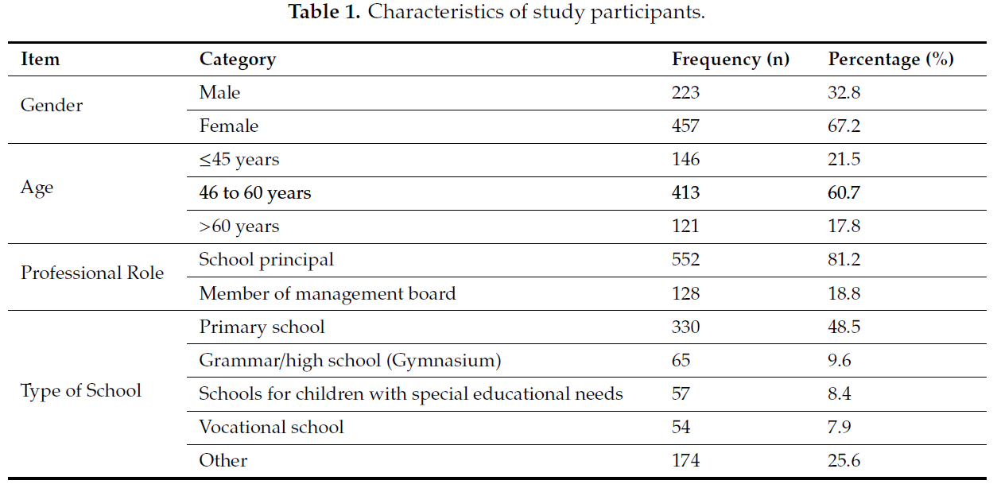
N=680

Slide 21
3.2. 單變量與雙變量之分析結果(1)
超過三分之二的受訪者有足夠的健康識能，佔70.7% 。
23.5%受訪者健康識能是有問題的。
而5.8% 受訪者健康識能識不足的。
表2顯示健康識能的等級，(其中將有問題的健康識能problematic和不足的健康識能inadequate合併為不足的健康識能limited health literacy)，在性別方面發現男性領導者健康識能不足的比例較高。 (34.9% vs. 26.5%, χ²(1) = 4.87, p < 0.05)
Notes:
70.7% more than two thirds of all respondents reported a sufficient level of health literacy,
23.5% had a problematic health literacy,
5.8% an inadequate health literacy.
Table 2 shows health literacy levels (i.e., problematic and inadequate health literacy were combined to limited health literacy), stratified by sociodemographic and work characteristics.
With regard to gender, chi square tests revealed a significant deference with a higher percentage of limited health literacy found for male compared to female leaders (34.9% vs. 26.5%, χ²(1) = 4.87, p < 0.05).

Slide 22
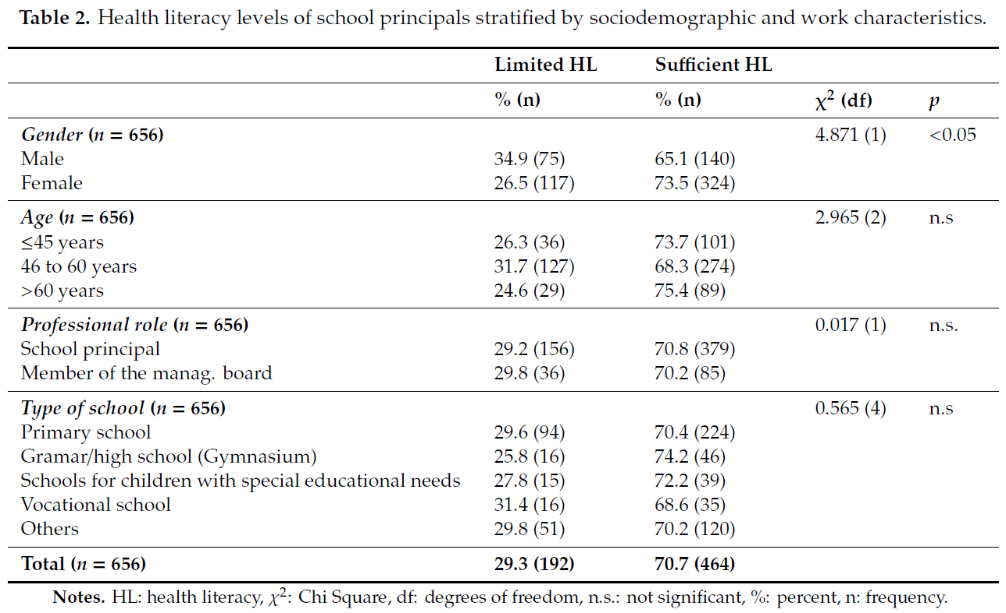

Slide 23
3.2.單變量與雙變量之分析結果(2)
表3顯示健康識能Health Literacy與健康促進學校實施等級Level of HPS implementation (r = 0.11, p < 0.001)、健康促進學校能力HPS competencies (r = 0.12, p < 0.001)、職業的自我效能occupational self-efficacy (r = 0.16, p < 0.001)之間具有較低的相關，但達顯著相關。
此外，健康促進學校實施等級Level of HPS implementation與健康促進學校之態度HPS attitudes (r = 0.34, p < 0.001)及健康促進學校能力HPS competencies (r = 0.41, p < 0.001)具有中度相關，而職業的自我效能occupational self-efficacy (r = 0.12, p < 0.001)有低度的相關達顯著相關
Notes:
There were small but statistically significant associations between health literacy and level of HPS implementation (r = 0.11, p < 0.001), HPS competencies (r = 0.12, p < 0.001), and occupational self-efficacy (r = 0.16, p < 0.001).
Furthermore, level of HPS implementation as dependent variable correlated on a moderate level with HPS attitudes (r = 0.34, p < 0.001) and HPS competencies (r = 0.41, p < 0.001), while small associations with occupational self-efficacy (r = 0.12, p < 0.001) could be found.

Slide 24
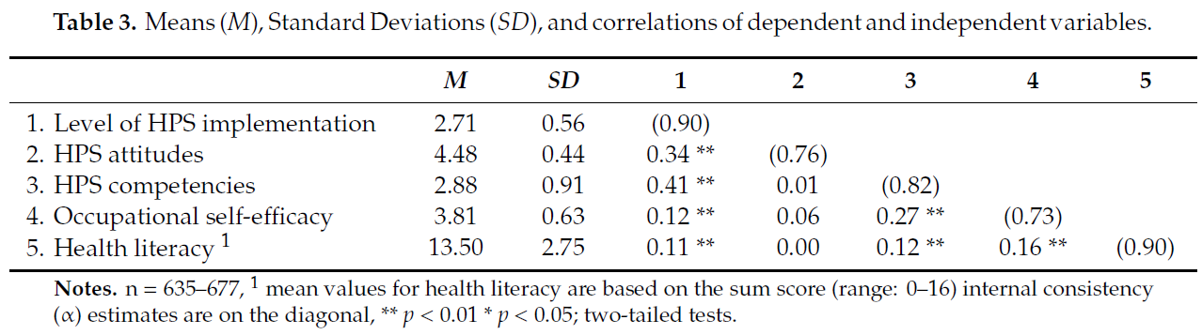

Slide 25
3.3. 多變量的分析結果
表4結果發現只有性別gender 、專業角色professional role與健康促進學校實施狀態具有相關(區集1) 。
然而在區集2中，健康促進學校之態度HPS attitudes(HPS attitudes = OR: 3.17, 95% CI: 2.13–4.72與能力HPS competencies (OR: 3.66, 95% CI: 2.43–5.50) 同樣與健康促進學校實施狀態達顯著相關。
最後區集3則顯示健康識能health literacy與健康促進學校實施狀態level of and the implementation status of the HPS之間存在著重要的關聯性 。(Health literacy = OR: 1.61, 95% CI: 1.04–2.49)
Notes:
only gender and professional role were significantly associated with the implementation status of the HPS (block 1).
HPS attitudes and competencies showed significant associations with the implementation status (HPS attitudes = OR: 3.17, 95% CI: 2.13–4.72; HPS competencies = OR: 3.66, 95% CI: 2.43–5.50). (block 2)
significant associations between the level of health literacy and the implementation status of the HPS. (Health literacy = OR: 1.61, 95% CI: 1.04–2.49) (block 3)

Slide 26
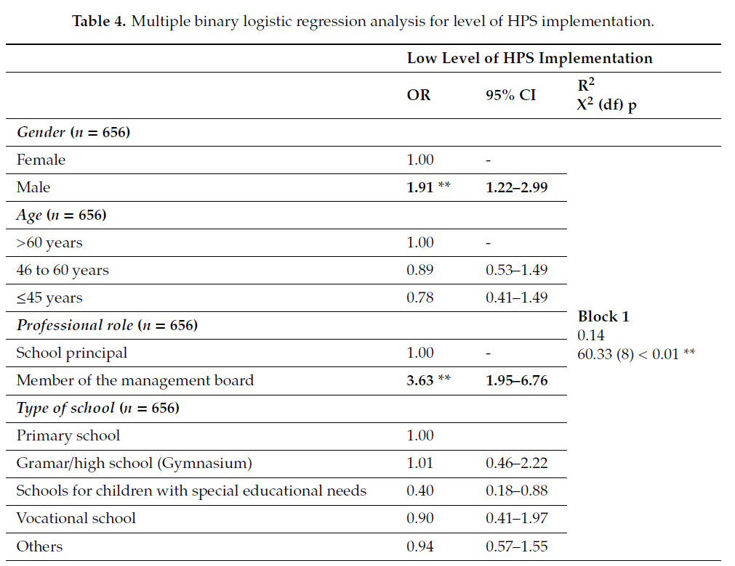

Slide 27
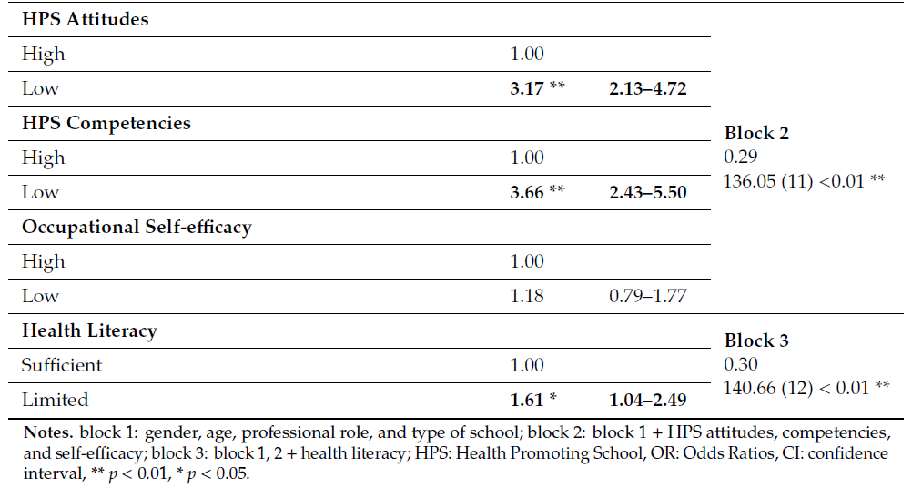

Slide 28
3.3. Results of Multivariate Analyses
依照性別進行二元邏輯斯迴歸分析
學校管理委員會成員(membership of the school management board)中健康促進學校實施狀態與健康識能之男性及女性領導者有顯著相關。 (male = OR: 4.43, 95% CI: 1.47–13.35; female = OR: 3.81, 95% CI: 1.74–8.34).
而對健康促進學校之態度較低(low HPS attitudes)的男性領導者中，健康促進學校的實施等級較低的可能性更高。(male = OR: 4.24, 95% CI: 1.92–9.28; female = OR: 3.07, 95% CI: 1.90–4.94)
女性領導者對於健康促進學校能力(HPS competencies)相對較高於男性。 (male = OR: 2.81, 95% CI: 1.27–6.23; female = OR: 4.21, 95% CI: 12.59–6.86).
最後僅在男性中發現不足的健康識能(limited health literacy)與低健康促進學校實施狀態具有顯著關聯性。 (OR: 2.81, 95% CI: 1.22–6.45).
Notes:
calculated multiple binary logistic regressions stratified by gender.
membership of the school management board (e.g., vice principal) was significantly associated with lower HPS implementation for female and male respondents (male = OR: 4.43, 95% CI: 1.47–13.35; female = OR: 3.81, 95% CI: 1.74–8.34). (block 1).
While male school leaders with low HPS attitudes showed a higher increase of the probability of a low level of HPS implementation (male = OR: 4.24, 95% CI: 1.92–9.28; female = OR: 3.07, 95% CI: 1.90–4.94), (block 2).
HPS competencies with higher odds ratios found for female leaders (male = OR: 2.81, 95% CI: 1.27–6.23; female = OR: 4.21, 95% CI: 12.59–6.86). (block 2).
significant associations between limited health literacy and low-level HPS implementation could only observed for male school leaders (OR: 2.81, 95% CI: 1.22–6.45). (block 3).

Slide 29
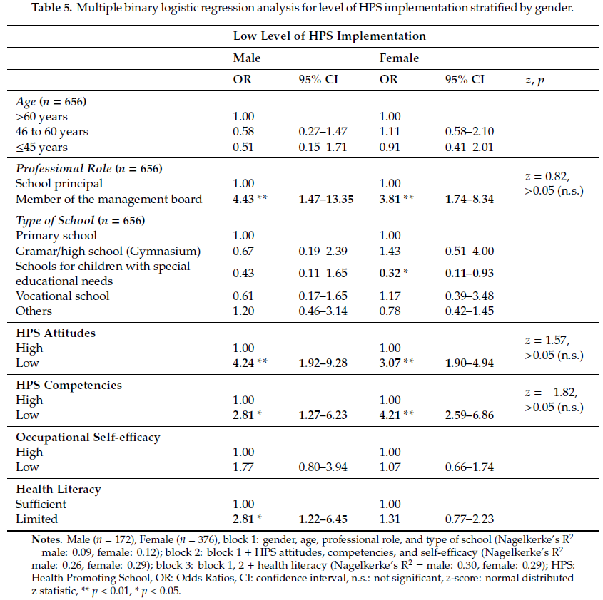

Slide 30
04
結論
Discussion

Slide 31
結論
第一，此研究主要是探討學校領導者的健康識能等級與學校實施健康促進學校狀態之關係。
第二，男性校長健康素養比女性校長更加受到健康識能不足的影響，（36.5％ 比 26.9％），因此特別需要為男性校長提供更多的支持。
第三，除了對健康識能等級有初步發現之外，研究結果更顯示，即使在控制了社會人口學和工作特性以及其他以學校領導者為導向的影響因素之後，健康識能也與健康促進學校的實施狀況有相關。
Notes:
Firstly, the level of health literacy of school leaders and its connection with the implementation status of health promotion in schools
Secondly, there is a particular need for support especially for male school leaders, who are more often affected by limited health literacy than female respondents (36.5% vs. 26.9%).
Third, besides initial findings on the level of health literacy, the main results of our study indicate that health literacy is linked to the implementation status of the HPS even after controlling for sociodemographic and work characteristics as well as further school-leader oriented influencing factors

Slide 32
結論
健康促進學校的態度和能力對於實施健康促進學校不論在男性或是女性的學校領導者中，皆為重要的預測指標。
健康促進學校能力更著重於行動能力，其實就是使這些人能夠執行某些行動的具體能力（例如推動學校健康）(Jensen, 2000)。
Notes:
HPS attitudes and competencies served as significant predictors for HPS implementation for both male and female school leaders
HPS competencies focus more on action competencies, i.e., concrete capacities that allow people to perform certain actions (e.g., on school health promotion) (Jensen, 2000).

Slide 33
結論
1. 溝通
2. 有效的課程導向的領導力
4.學校法規訂定
5. 改變管理的過程
3. 學校的預算管理
對於黑森聯邦州，準學校校長的資格認證階段包括五個模組(如右圖)，每個模組約持續時間為2至3天，大約在12個月的時間內結束。
例如，增強個人的應變能力並強化有益健康的行動能力。
然而，學校校長的資格還沒有成功的解決健康這個跨領域的的問題
Notes:
For the federal state of Hesse, the qualification phase for prospective school principals comprises five modules with a duration of 2 to 3 days each, which are completed over the course of approximately 12 months.
e.g., promotion of individual resilience and strengthening of salutogenic action competence.
However, health as a cross-cutting issue has not yet been sufficiently addressed in the qualification of school principals.

Slide 34
研究限制
樣本不具有代表性，其結果不能推廣到德國黑森邦中所有學校的領導者
本研究屬於的橫斷面性研究，有關健康識能與健康促進學校間的關聯的結果不能解釋為因果關係
學校領導者是這項研究的唯一訊息來源，這可能導致有效性受到限制
Notes:
the sample is not representative and the results cannot be generalised to the whole population of school leaders in the federal state of Hesse
based on the cross-sectional design of this study, the results concerning the association between health literacy and level of HPS implementation cannot be interpreted as causal relationships
school leaders were the only source of information in this study, which may have led to limitations in validity

Slide 35
05
討論
Conclusions

Slide 36
討論(1)
此研究為第一個研究學校校長和學校管理者健康識能的研究。
儘管學校領導者屬於良好教育程度的族群，但我們的研究結果表明，有將近三分之一(29.7%)的受訪者屬於健康識能不足的，因此，應該支持他們強化個人的搜索和學習能力、處理與健康有關訊息，包括使用和健康的決策。
Notes:
this is the first study examining the health literacy of school principals and school managers.
Although school leaders belong to a group with a high level of education, our results indicate that slightly less than a third of the respondents are affected by a limited health literacy and, hence, should be supported in strengthening their individual abilities to search for and to deal with health-related information, including their use and healthy decision making

Slide 37
討論(2)
在這項研究中發現性別的差異，突顯出應該針對性別的行動來增強個人健康識能。
除了促進健康識能，這些活動還應包括增強對於健康促進學校的態度以及健康促進學校的能力。
未來研究需要更加確認本研究的結果(例如：關於性別的差異)，以及確認健康識能與組織實踐健康促進學校之間的因果關係。
Notes:
Gender difference found in this study underline the need for gender-specific actions to strengthen individual health literacy.
Next to the promotion of health literacy, these activities should also encompass strategies to strengthen attitudes and competencies towards HPS..
further research is needed to confirm the study results presented here (e.g., with regard to gender disparities) and to examine causal relationship between health literacy and organisational practices on school health promotion.

Slide 38


